Slide 1

CS4225/CS5425 Big Data Systems for Data Science
MapReduce & Data Mining
Bryan Hooi
School of Computing
National University of Singapore
bhooi@comp.nus.edu.sg

Slide 2
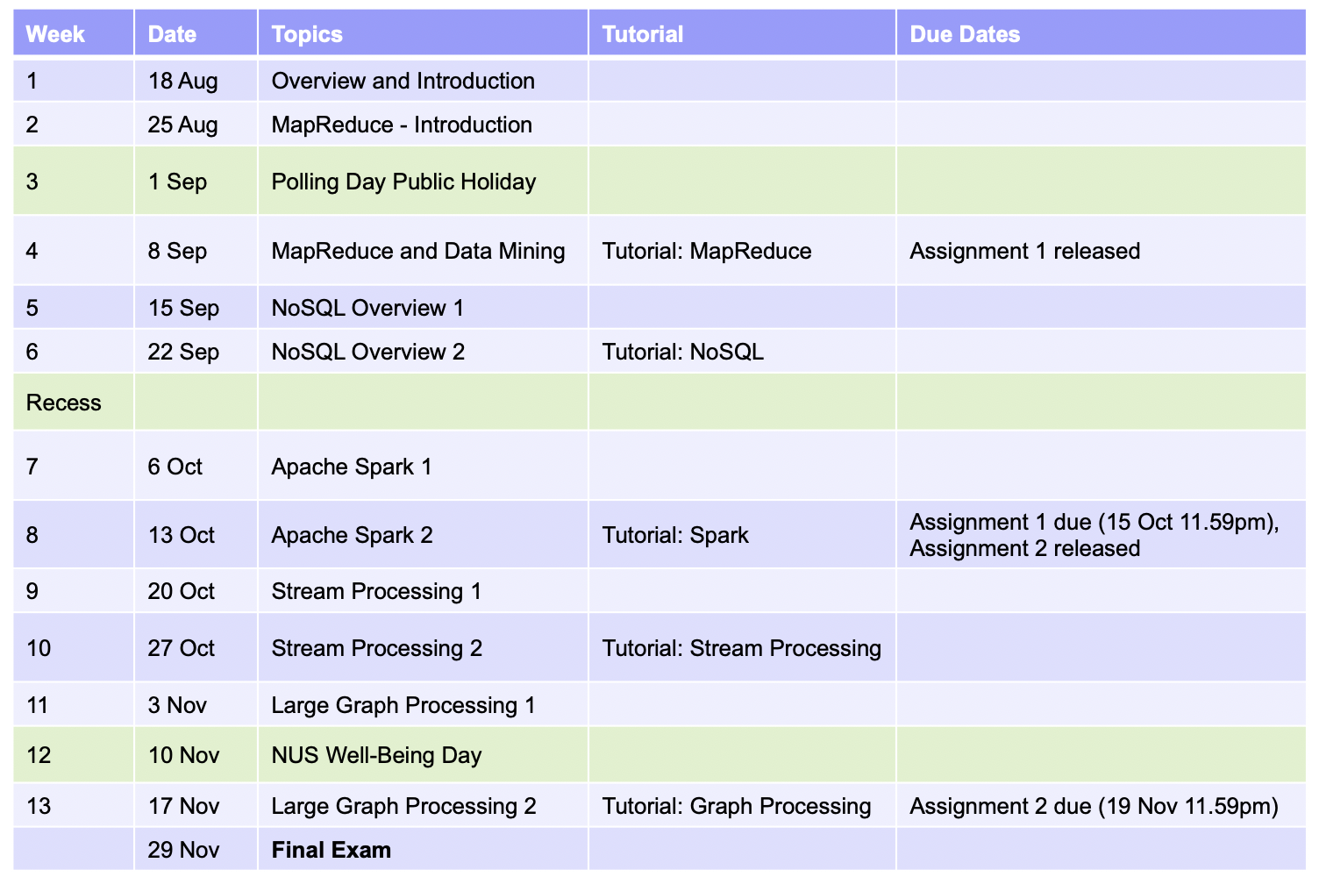
Announcements
Tutorial 1 will be held today after lecture.
Assignment 1 will be released this weekend.

Slide 3

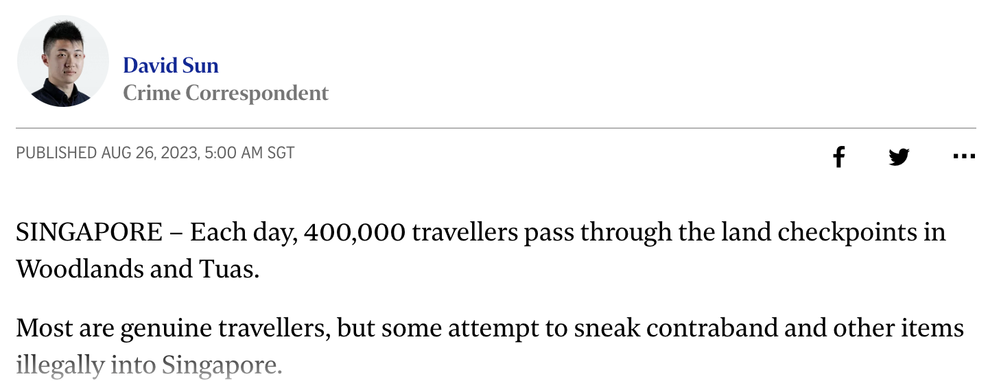

Slide 4
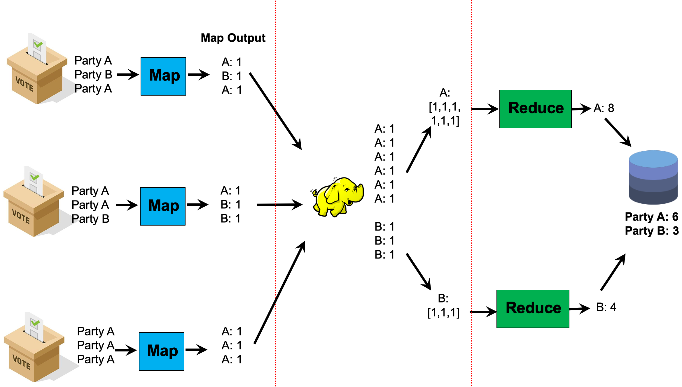
Recap: Partition Step
Note that key A went to reducer 1, and key B went to reducer 2
By default, the assignment of keys to reducers is determined by a hash function
e.g., key k goes to reducer hash(k) mod num_reducers
User can optionally implement a custom partition, e.g. to better spread out the load among reducers (if some keys have much more values than others)
%
4

Slide 5
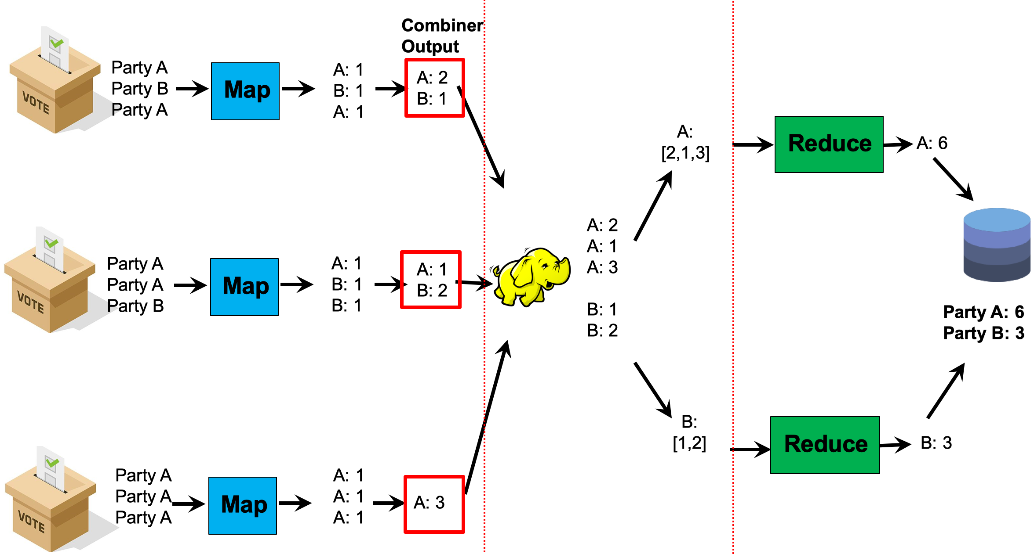
Recap: Combiner
The user must ensure that the combiner does not affect the correctness of the final output, whether the combiner runs 0, 1, or multiple times

Slide 6
Recap: MapReduce Implementation
User Program
(1) submit
Master
(2) schedule map
(2) schedule reduce
worker
split 0
(6) write
output
file 0
split 1
(5) remote read
worker
split 2
(3) read
(4) local write
split 3
worker
split 4
worker
output
file 1
worker
Input
files
Map
phase
Intermediate files
(on local disk)
Reduce
phase
Output
files
Shuffle phase
Adapted from (Dean and Ghemawat, OSDI 2004)

Slide 7
Preserving State in Mappers / Reducers
Mapper object
Reducer object
one object per task
state
state
setup
API initialization hook
setup
map
one call per input key-value pair
reduce
one call per intermediate key
cleanup
API cleanup hook
cleanup
Notes:
Recall that each map task and reduce task can process multiple key/value pairs… this diagram shows how we can maintain some stored state variables within a map/reduce task, across multiple map/reduce function calls.
To do this we define a mapper object, and then the mapper function can be called by this object, once per input key-value pair. The state is updated and maintained upon each function call.
During the execution of map/reduce, the state is updated.
After the mapper task is done, cleanup is needed, e.g., releasing the memory space.
“API initialization / cleanup hook” just means that the setup / cleanup functions will be called by Hadoop when the Mapper object is created / destroyed.

Slide 8
Recap: Combining HDFS and Hadoop
namenode
job submission node
namenode daemon
jobtracker
tasktracker
tasktracker
tasktracker
datanode daemon
datanode daemon
datanode daemon
Linux file system
Linux file system
Linux file system
…
…
…
slave node
slave node
slave node
Notes:
Combine Hadoop and HDFS together
Job tracker/task tracker for Hadoop runtime
Namenode and datanode processes for HDFS.
Namenode and job submission node can be the same or different machine.
Design philosophy: the same machines are used for both storing the data (HDFS) and processing it (Hadoop). This allows us to save time where possible, by “moving the task to the data”.

Slide 9
Secondary Sort
Problem: each reducer’s values arrive unsorted. But what if we want them to be sorted (e.g. sorted by temperature)?
Solution: define a new ‘composite key’ as (K1, K2), where K1 is the original key (“Natural Key”) and K2 is the variable we want to use to sort
Partitioner: now needs to be customized, to partition by K1 only, not (K1, K2)
Notes:
Q: What if we want the reducer’s (key, value) pairs to arrive sorted by a variable (e.g. temperature)?
A: We must deﬁne a composite key (K1, K2), where K1 is the natural key and K2 is the variable we want to sort by.
Then we must also implement a custom partitioner, to ensure that we partition by K1 and not by (K1, K2).
Lastly, in the reducer, we need to preserve state across multiple key-value pairs to handle processing.

Slide 10
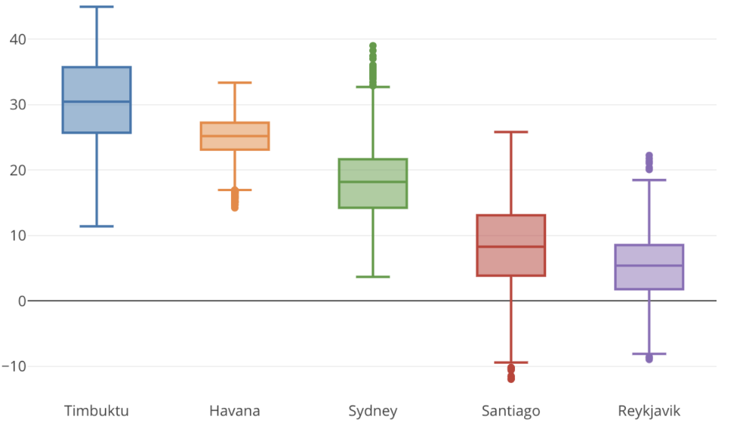
Secondary Sort: Example
Assume we want to compute some statistics (median, 25% quantile, etc.) of the data grouped by month.
Temperature
Month

Slide 11
Secondary Sort: Example
Assume we want to compute some statistics (median, 25% quantile, etc.) of the data grouped by month.
Our map function emits (month, temperature) tuples, so that tuples from the same month go to the same reducer.
However, the values (temperature) arrive at each reducer unsorted.
(Jan, 30ºC)
(Jan, 20ºC)
(Feb, 30ºC)
(Feb, 25ºC)
Jan: [30ºC, 20ºC]
Reducer 1
Mapper(s)
Reducer 2
Feb: [30ºC, 25ºC]

Slide 12
Secondary Sort: Example
Now suppose we use (month, temperature) as composite key, but without changing the partitioner.
The 4 tuples below have 4 different “values” of the composite key.
Recall that they will be partitioned by hashing the composite key values. So data with the same primary key may be sent to different reducers, which we don’t want (since we can’t compute the desired statistics for each month)
(Jan, 30ºC)
(Jan, 20ºC)
(Feb, 30ºC)
(Feb, 25ºC)
Reducer 1
Mapper(s)
Reducer 2

Slide 13
Secondary Sort: Example
Finally, secondary sort uses (month, temperature) as composite key, and uses a custom partitioner, to partition by month only.
Now we see that 1) data for the same month goes to the same reducer, and 2) at each reducer, data arrives sorted by temperature, since the MapReduce framework always sorts the data by key before giving it to each reducer.
(Jan, 30ºC)
(Jan, 20ºC)
(Feb, 30ºC)
(Feb, 25ºC)
Jan: [20ºC, 30ºC]
Reducer 1
Mapper(s)
Reducer 2
Feb: [25ºC, 30ºC]

Slide 14
Secondary Sort: Example
Q: Could we just sort the data ourselves in the reducer?
A: Yes, but it may be expensive (in memory & time) if there are a lot of tuples for one key. Secondary sort is effectively “borrowing” the inbuilt distributed sorting process of Hadoop to sort the tuples for us.
(Jan, 30ºC)
(Jan, 20ºC)
(Feb, 30ºC)
(Feb, 25ºC)
Jan: [20ºC, 30ºC]
Reducer 1
Mapper(s)
Reducer 2
Feb: [25ºC, 30ºC]

Slide 15

Overview
Relational Databases and MapReduce
Similarity Search
Clustering
Source: www.flickr.com/photos/rheinitz/6158837748/

Slide 16
Relational Databases
A relational database is comprised of tables.
Each table represents a relation = collection of tuples (rows).
Each tuple consists of multiple fields.
Sales
R₁
R₂
R₃
R₄
R₅
Notes:
A relational database is comprised of tables.
Each table represents a relation = collection of tuples (rows).
Each tuple consists of multiple fields.
You should have learnt those basic concepts in the previous course.
A brief history can be found: https://en.wikipedia.org/wiki/Relational_database

Slide 17
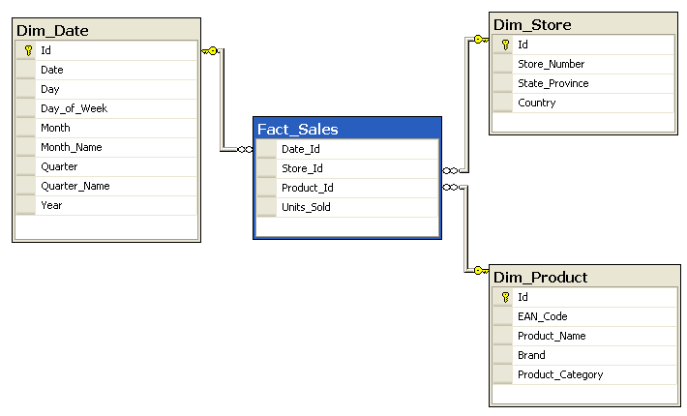
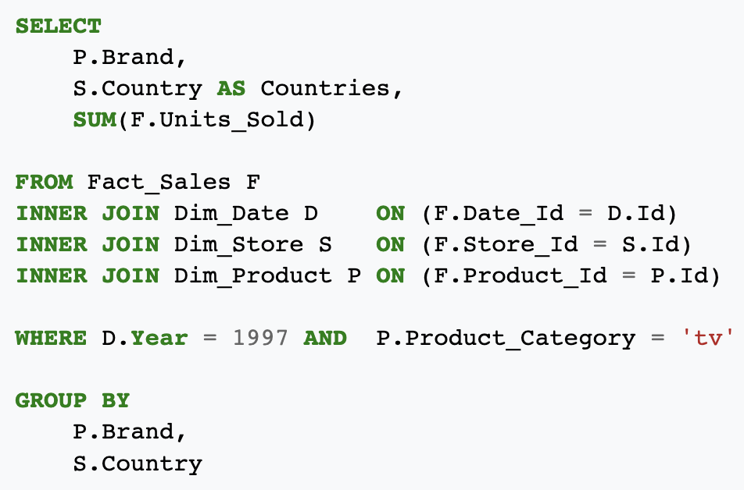
Star Schema and SQL Queries
Source: Wikipedia (Star Schema)
Notes:
“Star schema” is one of the simplest and most popular ways of organizing multiple data tables.
It consists of a fact table and a number of dimension tables. Generally, the fact table contain business events, e.g. ”a sale of product X in store Y”. Then, the dimension tables describe the set of products, and the set of stores. A simple analogy is that “dimension tables are analogous to nouns, but fact tables are analogous to verbs”. The fact tables typically contain foreign keys which reference primary keys which are described in the dimension tables.

Slide 18
Projection
SELECT , FROM Sales
Sales
Output
R₁
R₁
R₂
R₂
R₃
R₃
R₄
R₄
R₅
R₅
Notes:
R1, R2… R5 are rows… fields in the same column are represented in the same shape.
Thus, projection is to get one or multiple columns.

Slide 19
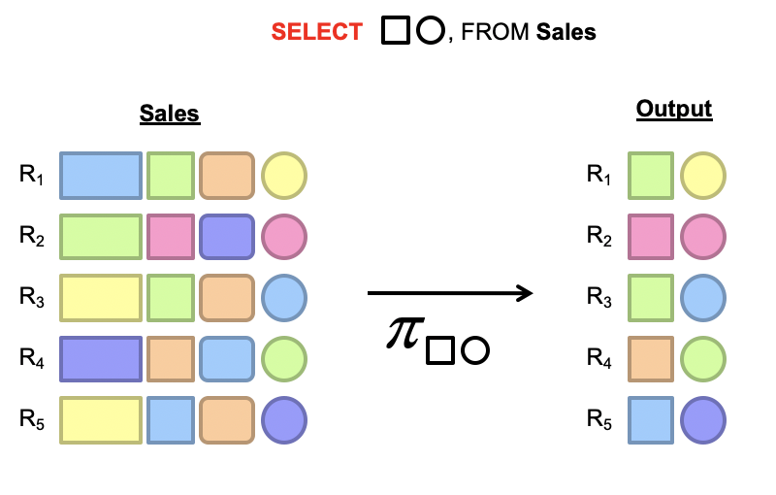
Projection in MapReduce
Map: take in a tuple (with tuple ID as key), and emit new tuples with appropriate attributes
No reducer needed (⇒ no need shuffle step)
Notes:
The implementation is quite straightforward.
Map: take <tuple id, tuple> as input, and emit <tuple id, fields>
Do we need a reducer? No. This is a map only job, which are quite efficient as no shuffle phase is needed.
Alternatively, if we want to do a projection on the map output, we can also do it in reducer.
Let’s analyze the performance. I/O is the key bottleneck, and limited by the HDFS streaming read speed. thus the encoding/decoding is rather important. We can take advantage of compressions to reduce I/O.

Slide 20
Selection
predicate
SELECT * FROM Sales WHERE (price > 10)
R₁
R₂
R₁
R₃
R₃
R₄
R₅
Notes:
Selection is to do a filtering on the rows according to some filtering conditions (predicates).

Slide 21
Selection in MapReduce
Map: take in a tuple (with tuple ID as key), and emit only tuples that meet the predicate
No reducer needed
predicate
SELECT * FROM Sales WHERE (price > 10)
R₁
R₂
R₁
R₃
R₃
R₄
R₅
Notes:
The implementation is also rather easy.
Map: input <tuple id, tuple>, emit only the tuples that meet the criteria.
No reducers… but depending on the query. If grouping and order by is needed, then, we may have reducers.
Again, we can also do filtering in reduction, if there is other processing logics in the map task.
Let’s analyze the performance. It is similar to the projection.
I/O is the key bottleneck, and limited by the HDFS streaming read speed.
Very similar to projection.

Slide 22
Group by… Aggregation
Example: What is the average sale price per product?
In SQL:
SELECT product_id, AVG(price) FROM sales GROUP BY product_id
In MapReduce:
Map over tuples, emit <product_id, price>
Framework automatically groups these tuples by key
Compute average in reducer
Optimize with combiners
Notes:
Group by and aggregation is quite like word count… word count is simply count and group by word.
Let’s look at one example: suppose we have a visits table recording all the access log. Each log entry consists of two fields: URL and access time.
We want to check the average access time for each URL. The SQL is given in SELECT url, AVG(time) FROM visits GROUP BY url.
Now, we can see how we can implement the AVG and group by in this SQL.
Map: for each tuple, we emit <url, time>
Then, reduce will compute the average.
We can optimize it with combiners (similar to the average question in the tutorial). Please refer to the tutorial for more details of the further optimizations.

Slide 23
Relational Joins (‘Inner Join’)
Country
User_id
User_id
Module
R₁
S₁
R₂
S₂
R₃
S₃
R₄
S₄
Country
User_id
Module
R₁
S₂
R₂
S₄
R₃
S₁
R₄
S₁
Notes:
Key of R, Key of S.
R.key=S.key

Slide 24
Types of Relationships
Many-to-Many
One-to-Many
One-to-One
“Many to many” relationship: e.g. a particular user ID can appear multiple times, in both tables
Notes:
Many to many: student table, module table.
One to many: university table, student table
One to one: student id vs. email
You have already learnt this in database course.

Slide 25
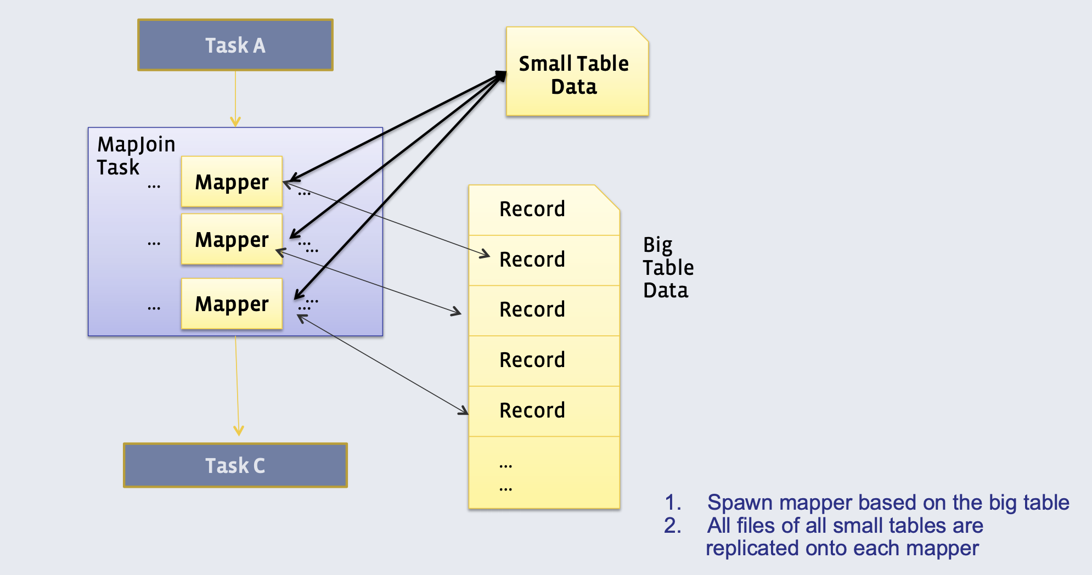
Method 1: Broadcast (or ‘Map’) Join
Requires one of the tables to fit in memory
All mappers store a copy of the small table (for efficiency: we convert it to a hash table, with keys as the keys we want to join by)
They iterate over the big table, and join the records with the small table
{0: [SG, MY],
1: [SG], …}

Slide 26
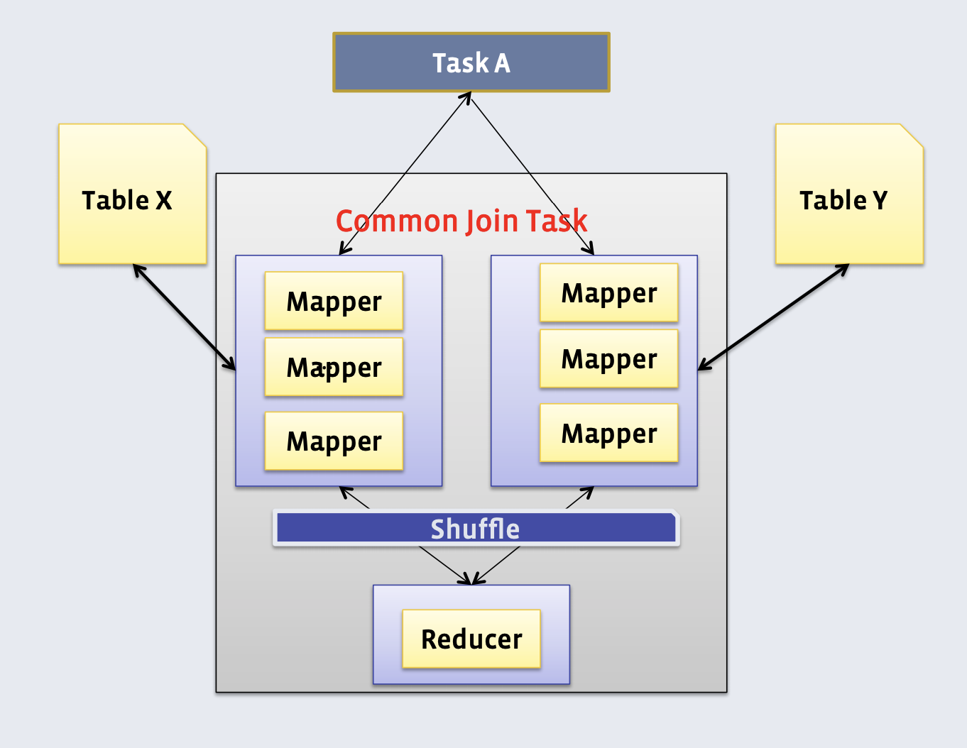
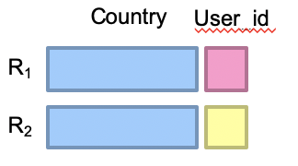
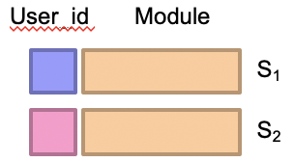
Method 2: Reduce-side (or ‘Common’) Join
Doesn’t require a dataset to fit in memory, but slower than broadcast join
Different mappers operate on each table, and emit records, with key as the variable to join by
Table X X
Table Y X
SG
0
…
0
CS4225
Map
Map
(0, X, SG)
(0, Y, CS4225)
key
Secondary key
Notes:
All the tuples from R with the same join key will be encountered ﬁrst, which
the reducer can buﬀer in memory. As the reducer processes each tuple from
S , it is crossed with all the tuples from R. Of course, we are assuming that
the tuples from R (with the same join key) will ﬁt into memory, which is a
limitation of this algorithm (and why we want to control the sort order so that
the smaller dataset comes ﬁrst).
The basic idea behind the reduce-side join is to repartition the two datasets by the join key. The approach isn’t particularly efficient since it requires shuf- fling both datasets across the network.

Slide 27
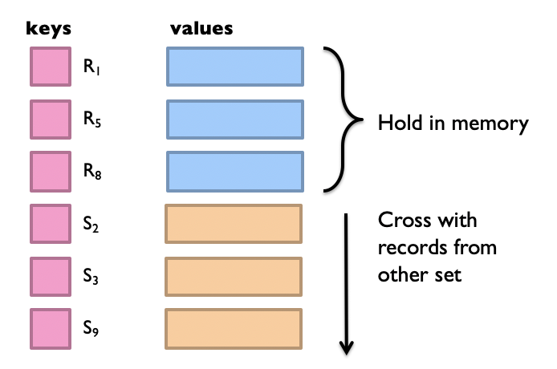
Method 2: Reduce-side (‘Common’) Join
In reducer: we can use secondary sort to ensure that all keys from table X arrive before table Y
Then, hold the keys from table X in memory and cross them with records from table Y
In reduce function for key 0:
key
Secondary key
0
X
SG
X
0
X
0
X
0
Y
CS4225
Y
0
Y
0
Y
Notes:
All the tuples from R with the same join key will be encountered ﬁrst, which
the reducer can buﬀer in memory. As the reducer processes each tuple from
S , it is crossed with all the tuples from R. Of course, we are assuming that
the tuples from R (with the same join key) will ﬁt into memory, which is a
limitation of this algorithm (and why we want to control the sort order so that
the smaller dataset comes ﬁrst).
The basic idea behind the reduce-side join is to repartition the two datasets by the join key. The approach isn’t particularly efficient since it requires shuf- fling both datasets across the network.

Slide 28
Overview
Relational Databases and MapReduce
Similarity Search
Clustering
Source: www.flickr.com/photos/rheinitz/6158837748/

Slide 29
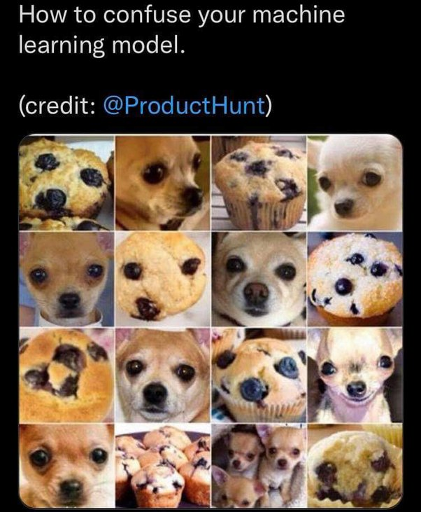
A Common Subroutine
Many problems can be expressed as finding “similar” objects:
Examples:
Pages with similar words
For duplicate detection, classification by topic
Customers who purchased similar products
Products with similar customer sets
Users who visited similar websites
Users with similar interests.
Notes:
Many problems can be expressed as finding similar sets. Generally, we want to find nearest neighbors in a high-dimensional space. Why high dimensional? See examples.
First, pages with similar words. Each word represents a dimension. Thus, high dimensions. This application can be used for duplicate detection and classification by topics.
Second, clusters who purchased similar products. Each product represents a dimension. Again, high dimension. We can do this for market segmentation.
Third, images with similar features. Features may be specific structures in the image such as points, edges or objects. It can be used for image search and clustering.
Fourth, users who visited similar websites.
All those data sets are with high dimensions, from thousands to tens of thousands, or even more.

Slide 30
Distance / Similarity Measures
We define “near neighbors” as points that are a “small distance” apart
To measure the distance between objects x and y, we need a function d(x, y) which we call a “distance measure”
Similarity measures are the opposite: lower distance = higher similarity, and vice versa
Notes:
When we say “similarity”, we need to have a metric to quantify it. That is, our goal is to find the nearest neighbors in a high dimensional space. We need to formally define that two objects are close enough (with a small distance from each other).
The distance definition can be different for various applications. For each application, we need to define what distance means.
In this lecture, we use Jaccard distance. This metric is defined on two sets, i.e., how similar the two sets are.
The Jaccard similarity of two sets is the size of their intersection divided by the size of their union. Jaccard similar is between 0 and 1. 0 means two sets have no intersection. 1 means two sets are the same.
The Jaccard distance is defined to be 1- Jaccard similarity.
Let’s see this example.

Slide 31

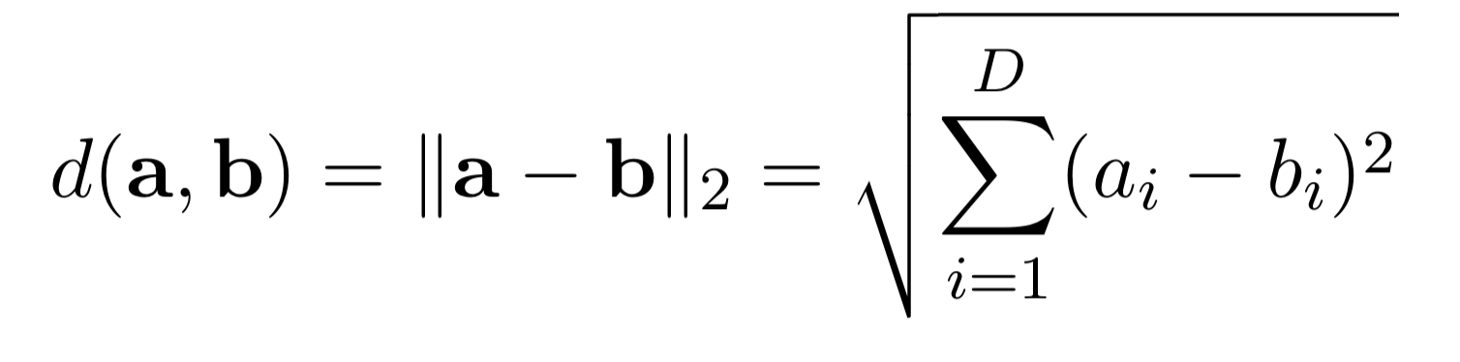
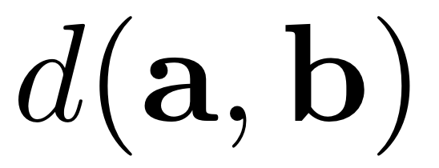

Common distance / similarity metrics
Euclidean distance

Slide 32
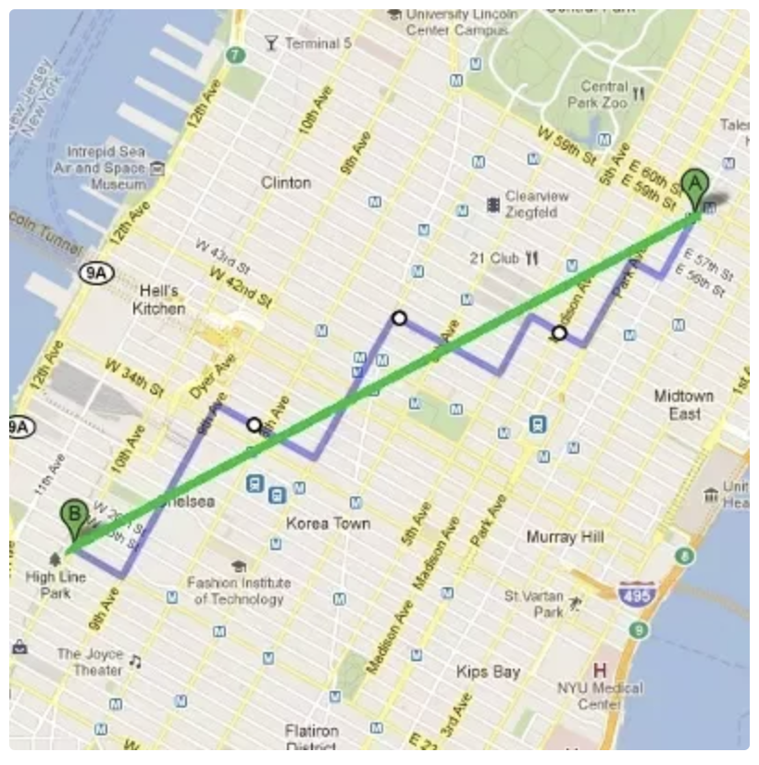
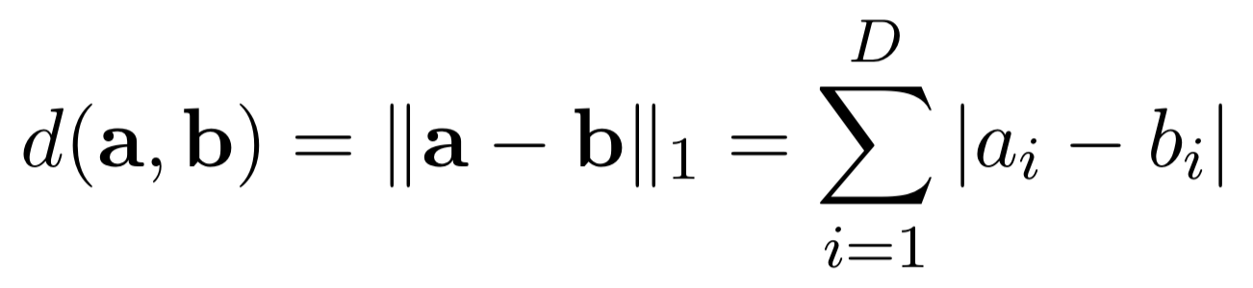
Common distance / similarity metrics
Manhattan distance

Slide 33
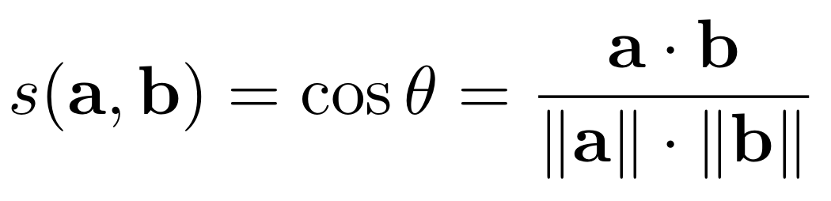
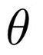
Common distance / similarity metrics
Cosine similarity
0
Only considers direction: cosine similarity doesn’t change if we scale a or b (i.e. multiplying them by a constant)

Slide 34



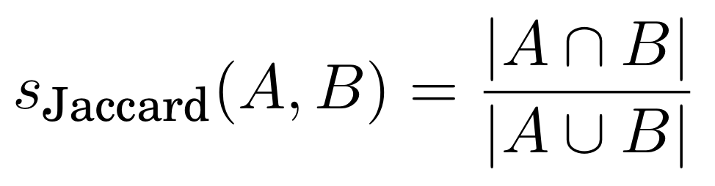
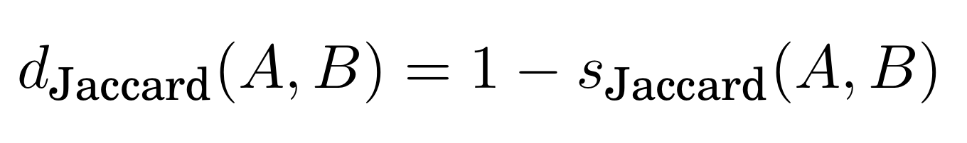
Common distance / similarity metrics
Jaccard Similarity (between sets A and B)
B = { , }
A = { , }
s_{Jaccard} =
= 1/3
, ,
Jaccard Distance

Slide 35
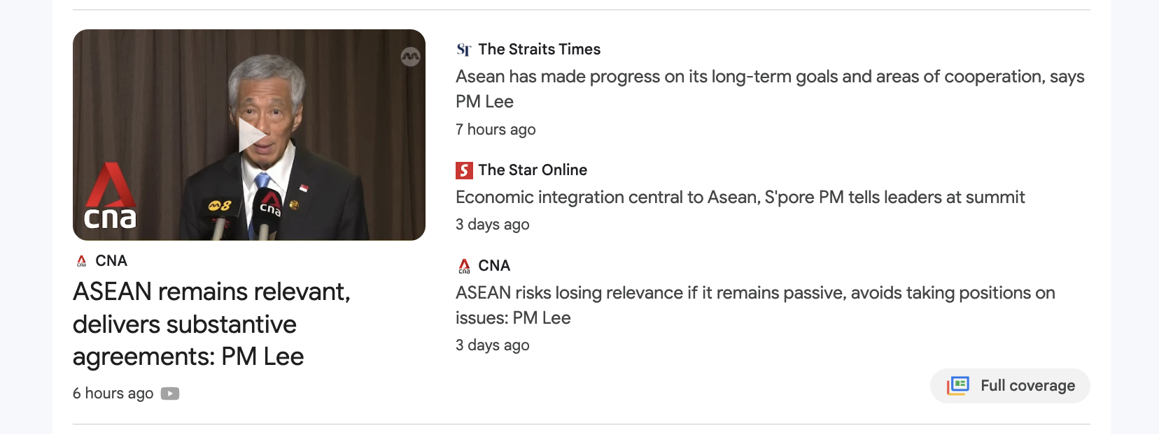
Task: Finding Similar Documents
Goals:
All pairs similarity: Given a large number N of documents, find all “near duplicate” pairs, e.g. with Jaccard distance below a threshold
Similarity search: Or: given a query document D, find all documents which are “near duplicates” with D
Applications:
Mirror websites, or approximate mirrors
Don’t want to show both in search results
Similar news articles
Cluster articles by “same story”
Notes:
We use documents as an example. Our goal is to fine near duplicate pairs of documents, given a large number of documents. The number can be millions or even billions.
There are many applications for this task: a) finding mirror websites, and approximate mirrors. In practice, we do not want to show duplications in the search results. B) finding similar news articles at many news sites.
The problem is tricky.
First, many small pieces of one document can appear out of order in another. However, they are still talking about the same story.
Second, the number of documents can be large. A pair-wise comparison can be time consuming.
Third, volume.

Slide 36
2 Essential Steps for Similar Docs
Shingling: Convert documents to sets of short phrases (“shingles”)
Min-Hashing: Convert these sets to short “signatures” of each document, while preserving similarity
A “signature” is just a block of data representing the contents of a document in a compressed way
Documents with the same signature are candidate pairs for finding near-duplicates

Slide 37
The Big Picture
Shingles:
{ (the cat),
(cat is),
(is glad) }
“the cat is glad…”
Signature: 182……231
Shingling
MinHash
Compare signatures to get candidate pairs
Document

Slide 38
Shingling
Shingles:
{ (the cat),
(cat is),
(is glad) }
“the cat is glad…”
Signature: 182……231
Shingling
MinHash
Compare signatures to get candidate pairs
Document
Step 1: Shingling: Convert documents to sets of phrases

Slide 39
Define: Shingles
A k-shingle (or k-gram) for a document is a sequence of k tokens that appears in the doc
Example: k=2; document D₁ = “the cat is glad” Set of 2-shingles: S(D₁) = {“the cat”, “cat is”, “is glad”}

Slide 40
Similarity Metric for Shingles
Each document D_{i} can be thought of as a set of its k-shingles C_{i}
E.g. D = “the cat is” ⇒ C = {’the cat’, ‘cat is’}
Often represented as a matrix, where columns represent documents, and shingles represent rows
We measure similarity between documents as Jaccard similarity:
sim(D₁, D₂) = |C₁∩C₂|/|C₁∪C₂|
Documents
D₁
D₂
…
“the cat”
1
1
1
0
“cat is”
1
1
0
1
…
0
1
0
1
Shingles
0
0
0
1
1
0
0
1
1
1
1
0
1
0
1
0
Notes:
Given the shingle definition, we can define the Jaccard similarity.
Jaccard distance = 1-Jaccard similarity.

Slide 41
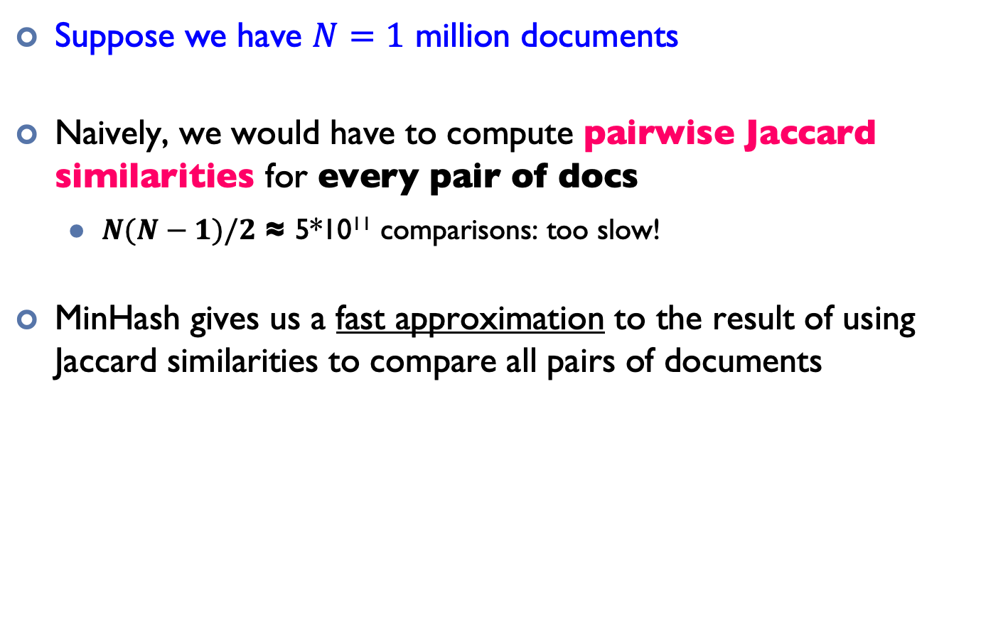
Motivation for MinHash
Suppose we have $N=1$ million documents
Naively, we would have to compute pairwise Jaccard similarities for every pair of docs
$N(N−1)/2$ ≈ 5*10¹¹ comparisons: too slow!
MinHash gives us a fast approximation to the result of using Jaccard similarities to compare all pairs of documents
Notes:
Given the jaccard definition, we can have a naïve approach for pairwise jaccard similarity calculation for every pair of documents. However, that will take a long time…
Any improvement? The key issue is that we have a too large number of jaccard similarity calculations as well as the costly calculations. Can we reduce them?

Slide 42
MinHashing
Shingles:
{ (the cat),
(cat is),
(is glad) }
“the cat is glad…”
Signature: 182……231
Shingling
MinHash
Compare signatures to get candidate pairs
Document
Step 2: MinHash: Convert large sets to short signatures, while preserving similarity
Notes:
Minhashing: Convert large sets to short signatures, while preserving similarity

Slide 43
MinHash: Overview
Key idea: hash each column C to a small signature h(C), such that:
(1) h(C) is small enough that the signature fits in RAM
(2) highly similar documents usually have the same signature
Goal: Find a hash function h(·) such that:
If sim(C₁,C₂) is high, then with high probability, h(C₁) = h(C₂)
If sim(C₁,C₂) is low, then with high probability, h(C₁) ≠ h(C₂)
Notes:
Again, we use hashing. “hash” each column C to a small signature h(C)
Essentially, we Hash docs into buckets. Expect that “most” pairs of near duplicate docs hash into the same bucket!

Slide 44
MinHash: Steps
Given a set of shingles, { (the cat), (cat is), (is glad) }
We have a hash function h that maps each shingle to an integer: h(“the cat”) = 12, h(“cat is”) = 74, h(“is glad”) = 48
Then compute the minimum of these: min(12, 74, 48) = 12
Notes:
Now, let’s explain how min-hashing works.
random permutation π: we can randomly shuffle the rows in the matrix.
The “hash” function is defined on a column. The hash value is the index of the first (in the permuted order π) row in which column C has value 1.
Essentially, one permutation is a hash function. Thus, we can use several (e.g., 100) independent hash functions (that is, permutations) to create a signature of a column. The signature length is actually how many times for random permutation.

Slide 45
Example: MinHash on 2 sets of shingles
Document 1
Document 2
{ (the cat), (cat is), (is glad) }
{ (no cat), (cat is), (is glad) }
Hashes:
32
12
24
93
12
24
MinHash:
MinHash = 12
MinHash = 12
Recall that we want to ensure that highly similar documents have high probability to have the same MinHash signature

Slide 46
Key Property of MinHash
Key property: the probability that two documents have the same MinHash signature is equal to their Jaccard similarity!
Formally: Pr[h(C₁) = h(C₂)] = Jaccard-Sim(C₁, C₂)
Proof (not required knowledge):
Document 1
Document 2
{ (the cat), (cat is), (is glad) }
{ (no cat), (cat is), (is glad) }
Hashes:
32
12
24
93
12
24
MinHash = 12
MinHash = 12
Set of all our tuples:
{(the cat), (no cat), (cat is), (is glad)}
Jaccard sim = 2/4 = 0.5
(2 non-shared shingles)
(2 shared shingles)
Among these 4 tuples, each has the same probability of having the smallest hash value.
if one of the red shingles has the smallest hash, the documents will have the same MinHash.
Otherwise, they will have different MinHashes.
=> Pr[h(C₁) = h(C₂)] = (red shingles / total shingles) = (intersection / union) = Jaccard similarity

Slide 47
Putting it all together
Shingles:
{ (the cat),
(cat is),
(is glad) }
“the cat is glad…”
Signature: 182……231
Shingling
MinHash
Compare signatures to get candidate pairs
Document
Candidate pairs: the documents with the same final signature are “candidate pairs”. We can either directly use them as our final output, or compare them one by one to check if they are actually similar pairs.
Extension to multiple hashes: in practice, we usually use multiple hash functions (e.g. N=100), and generate N signatures for each document. “Candidate pairs” can be defined as those matching a ‘sufficient number’ (e.g. at least 50) among these signatures.

Slide 48
MapReduce Implementation
Map
Read over the document and extract its shingles
Hash each shingle and take the min of them to get the MinHash signature
Emit <signature, document_id>
Reduce
Receive all documents with a given MinHash signature
Generate all candidate pairs from these documents
(Optional): compare each such pair to check if they are actually similar
Notes:
After “Reduce: LSH on each band, and emit the buckets.”, we can union the buckets (again, it can be a mapreduce job).
Parallelism is limited by #bands.
We can consider emit <band id, bucket id> as the key.
In the LSH:
Map: Perform band hashing, and emit <band id+bucket id, document id>
Reduce: emit the candidate pairs from the band and bucket (they already hash to the same bucket).

Slide 49
Overview
Relational Databases and MapReduce
Similarity Search
Clustering
Source: www.flickr.com/photos/rheinitz/6158837748/

Slide 50




Slide 51
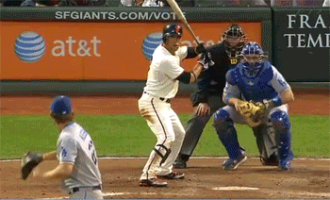

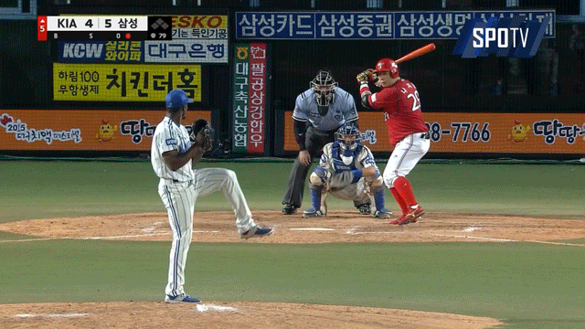
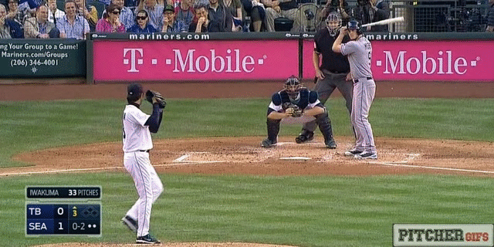


Slide 52
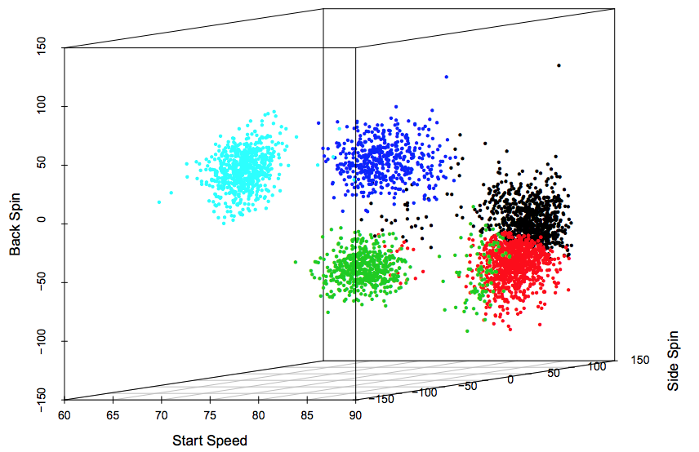
Pitches by Barry Zito
Pitches by Barry Zito
Back Spin
Back Spin
Side Spin
Start Speed
Pane, Michael A. "Trouble with the curve: identifying clusters of MLB pitchers using improved pitch classification techniques." (2013).

Slide 53
Pitches by Barry Zito
Curveball
Slider
Back Spin
Fastball
Changeup
Side Spin
Start Speed
Sinker
Pane, Michael A. "Trouble with the curve: identifying clusters of MLB pitchers using improved pitch classification techniques." (2013).

Slide 54
Goal of clustering
Clustering separates unlabelled data into groups of similar points.
Clusters should have high intra-cluster similarity, and low inter-cluster similarity.
Groups

Slide 55

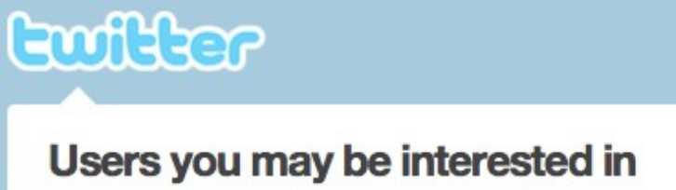
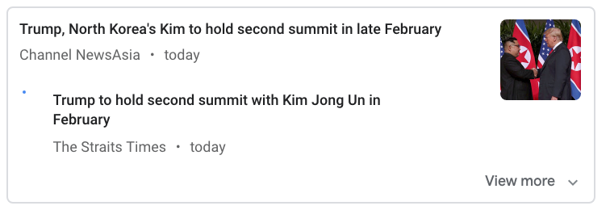

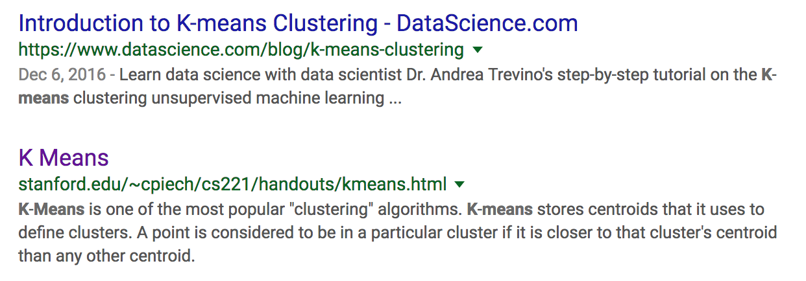
Applications of clustering
Many applications:
Microbiology: find groups of related genes (or proteins etc.)
Recommendation & Social Networks: find groups of similar users
Search & Information Retrieval: grouping similar search (or news etc.) results

Slide 56
K-Means Algorithm: Steps
1. Initialization: Pick K random points as centers
2. Repeat:
a) Assignment: assign each point to nearest cluster
Centers
b) Update: move each cluster center to average of its assigned points
Stop if no assignments change

Slide 57
K-Means Algorithm: Steps
1. Initialization: Pick K random points as centers
2. Repeat:
a) Assignment: assign each point to nearest cluster
b) Update: move each cluster center to average of its assigned points
Stop if no assignments change

Slide 58
K-Means Algorithm: Steps
1. Initialization: Pick K random points as centers
2. Repeat:
a) Assignment: assign each point to nearest cluster
b) Update: move each cluster center to average of its assigned points
Stop if no assignments change

Slide 59
K-Means Algorithm: Steps
1. Initialization: Pick K random points as centers
2. Repeat:
a) Assignment: assign each point to nearest cluster
b) Update: move each cluster center to average of its assigned points
Stop if no assignments change

Slide 60
K-Means Algorithm: Steps
1. Initialization: Pick K random points as centers
2. Repeat:
a) Assignment: assign each point to nearest cluster
b) Update: move each cluster center to average of its assigned points
Stop if no assignments change

Slide 61
K-Means Algorithm: Steps
1. Initialization: Pick K random points as centers
2. Repeat:
a) Assignment: assign each point to nearest cluster
b) Update: move each cluster center to average of its assigned points
Stop if no assignments change

Slide 62
K-Means Algorithm: Steps
1. Initialization: Pick K random points as centers
2. Repeat:
a) Assignment: assign each point to nearest cluster
b) Update: move each cluster center to average of its assigned points
Stop if no assignments change

Slide 63
K-Means Algorithm: Steps
1. Initialization: Pick K random points as centers
2. Repeat:
a) Assignment: assign each point to nearest cluster
b) Update: move each cluster center to average of its assigned points
Stop if no assignments change

Slide 64
K-Means Algorithm: Steps
1. Initialization: Pick K random points as centers
2. Repeat:
a) Assignment: assign each point to nearest cluster
b) Update: move each cluster center to average of its assigned points
Stop if no assignments change

Slide 65
K-Means Algorithm: Steps
1. Initialization: Pick K random points as centers
2. Repeat:
a) Assignment: assign each point to nearest cluster
b) Update: move each cluster center to average of its assigned points
Stop if no assignments change

Slide 66
MapReduce Implementation v1
This MapReduce job performs a single iteration of k-means. It receives as input the current positions of the cluster centers (i.e. stars)
Network traffic!
What is the problem?
Notes:
To apply this to the MapReduce framework, we find the cluster membership for each point in the mapper, emitting the point’s nearest cluster number as the key and the point itself as the value. The points are extended by one dimension and initialized to a value of one to represent the count for cluster normalization. For simplicity, we load the current cluster estimate into memory in the mapper; however, later we will discuss a method that can be used when the clusters are too large to fit into memory. The MapReduce framework will group the points by their nearest cluster. The reducer sums all of the points and normalizes to produce the updated cluster center, which is emitted as the value with the key being the cluster number. A ‘driver’ program orchestrates the communication of the new clusters to the mapper during the next k-means iteration. In practice the previous implementation will perform poorly as the entire dataset will be transferred over the network during the shuffle phase, resulting in a bottleneck due to the high network traffic. We can dramatically improve the performance by observing that the cluster mean computation requires the sum of all of the points and their cardinality.

Slide 67
Q: How much disk I/O is exchanged between the mappers and reducers, in MapReduce K-means v1? (let n = no. of points, m = no. of iterations, d = dimensionality, k = no. of centers)
O(n)
O(md)
O(nmd)
O(kmd)

Slide 68
Q: How much disk I/O is exchanged between the mappers and reducers, in MapReduce K-means v1? (let n = no. of points, m = no. of iterations, d = dimensionality, k = no. of centers)
O(n)
O(md)
O(nmd)
O(kmd)

Slide 69
MapReduce Implementation v2 (with in-mapper combiner)
Notes:
In-Mapper Combiner
By using the in-mapper combining design pattern, the initial algorithm is modified to not emit during calls to the Map method, and instead accumulate the partial sums until the Close method is called after all of the input has been processed. This decreases the amount of data that is emitted between the mapper to the combiner and the time taken to sort the mapper’s output for the combiner.

Slide 70
Q: How much disk I/O is exchanged between the mappers and reducers, in MapReduce K-means v2? (let n = no. of points, m = no. of iterations, d = dimensionality, k = no. of centers) (you may assume there is only 1 map task)
O(n)
O(md)
O(nmd)
O(kmd)

Slide 71
Q: How much disk I/O is exchanged between the mappers and reducers, in MapReduce K-means v2? (let n = no. of points, m = no. of iterations, d = dimensionality, k = no. of centers) (you may assume there is only 1 map task)
O(n)
O(md)
O(nmd)
O(kmd)

